Slide 1



CMS Ratings Project Approach and EDA
Group Members:
Preethi Doravari
Prachi Agrawal
Poorva Sawant
Rohith Krishnamurthy

Slide 2





Project analysis slide 4
About CMS
CMS rates hospitals in the US on a scale of 1-5, with the objective of making it easier for patients and consumers to compare the quality of services offered by hospitals.
Hospitals' revenues – Impacted by the choice of hospitals by the consumers
Hospital Compare website - Dataset
General information
Survey of patients' experiences
Timely & effective care
Complications
Readmissions & deaths
Use of medical imaging
Payment & value of care
Developing an approach by considering all the important measures
Calculate hospital ratings
Areas of improvement for Hospitals

Slide 3
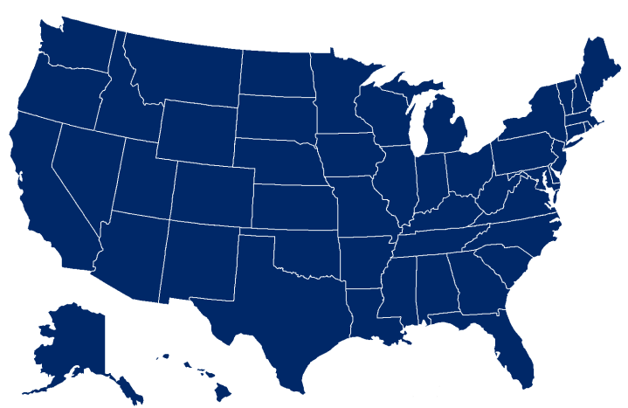
Project analysis slide 8
Input Data &
Objective
Mortality
Readmissions
Safety of Care
From the entire set of files downloaded from the CMS website; we verified the data and identified the relevant ones based on the measures alongside.
All the individual measure ids from different files have been classified as 7 measures groups
These 7 measures can be in turn clubbed in 4 measure categories based on the weightages.
Outcomes
Patient Experience
HCAHPS Survey
~1600
Process of Care
Timeliness of care
Effectiveness of care
Hospitals Evaluated
With these inputs, the purpose of the analysis is to define the approach to the ‘CMS rating problem.
from the United States of America
Efficiency of Care
Efficient use of medical Imaging

Slide 4
Project analysis slide 2
Action Plan
1) Data Cleaning
6) Model Building
Evaluation & Recommendations
Approach & EDA
2) Univariate/Bivariate Analysis
5) PCA & Normalization
3) Merge the data files and
calculate weighted scores for every measure
4) Redistribute missing score and calculate overall rating

Slide 5



Project analysis slide 8
Data Cleaning
Cleaning
Remove Columns that have blank data for all the rows
Drop all columns with Zero or null values/Single same value
Post merging – eliminate the rows for Hospitals that are not eligible for overall rating based on the measures they have reported (at least 3 measure groups including 1 from outcomes.)
Type Conversion
Convert object types to numeric type or date wherever required
Sanity Check
Remove columns that are irrelevant to analysis based on domain wisdom

Slide 6

Project analysis slide 8
Merge Data
Merge Data files :
We individually cleaned the given data files.
Clubbed the files by measure groups.
Calculated weighted scores for individual measures and measure groups.
Visualize the data for each measure group (visuals are attached in the upcoming slides)
Inferences and final Dataset:
Based on the analysis above we draw some insights.
Further we will merge these individual measure groups to one file to calculate overall rating
This will be the final dataset that will be used for PCA/Normalization and Model Building.

Slide 7
Project analysis slide 8
Approach for
Calculations
Derived Metrics:
Calculated weighted average for each group using the loading coefficient.. As per mentor's guidance, we have used loading coefficients for each measure in the group from Deloitte pdf (refer pages:17 to 21).
Each measure we have multiplied with the loading coefficient and then calculated the average of these for final group score.
Later we calculate the final score using all the group scores and respective weightage (22% for few and 4% for few).
This is used for assigning star rating for the hospital (We haven’t completed this step yet)

Slide 8
Project analysis slide 2
EDA graphs for
Sample Measures

Slide 9
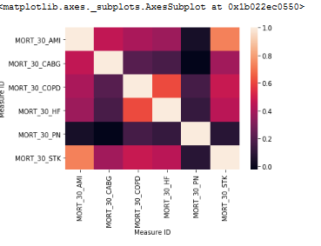
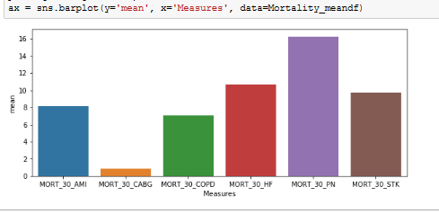
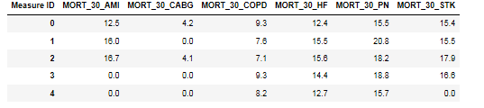
Project analysis slide 8
EDA
Mortality
EDA
Check for correlations after cleaning the data by measures (heat map)
Check the mean scores for each measure (bar chart)
Final Dataset for mortality measure group is also given alongside.

Slide 10
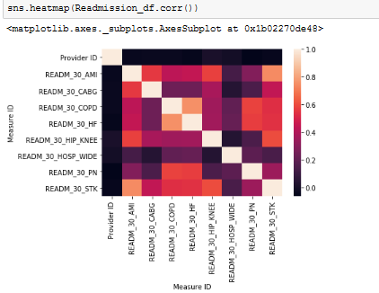
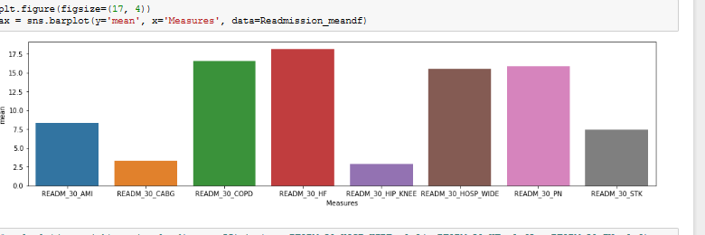
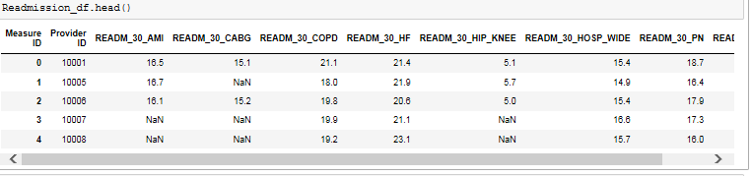
Project analysis slide 8
EDA
Readmissions
EDA
Check for correlations after cleaning the data by measures (heat map)
Check the mean scores for each measure (bar chart)
Final Dataset for readmissions measure group is also given alongside.

Slide 11
Project analysis slide 2
Attachment
Here is the Data cleaning and EDA code for two measures – Mortality and Recommendations.
We have applied similar approach and cleaned /merged files for other measures.

Slide 12
Project analysis slide 2
Future Roadmap

Slide 13
Project analysis slide 8
Approach for
Model Building
Data Preperation
We will have the final dataset based on the given measure groups /categories.
Create dummies (wherever needed)
Now we should normalize the data using Quantile Transformer which would help in converting a particular distribution to a normal one. This will help us in getting a better linear regression model.
Standardize/rescale data (wherever needed)
To further reduce the number of features we can try to PCA (if needed) .
Supervised Learning Models
For the 1st part of the problem we need to calculate the ratings based on supervised learning models –
We can consider various supervised learning models such as Linear Regression , Random Forrest , Decision Tree , SVM etc.
Here as per the approach given we will consider building Linear Regression and Random Forest.

Slide 14
Project analysis slide 8
Approach for
Model Evaluation
Model Evaluation
We will evaluate the model based on the accuracy of the model.
We will further do hyper parameter tuning to ensure our model doesn’t oevrfit
Finally we compare the results for different values of hyper parameter for each model and pick the one that suits the most for our problem.
Compare the outcomes for both Linear regression model and Random Forest model and choose the final model for our problem.
Report and Insights
We will identify and report the important measures and insights about their predictive power.
Finally we report the overall accuracy of predictions using the actual star ratings for both the models.

Slide 15
Project analysis slide 8
Approach for
Clustering-Based Rating (Unsupervised)
Method Choice
We will either go for Latent variable analysis or derive our own approach for assigning weights to the variables.
Further if we go for our own method we can use various techniques based on our EDA for measures or use PCA to filter out less significant features etc.
Model Building and evaluation :
Calculate and report the weights of all the measures within the respective groups
Compare the weights obtained using this method with the ones obtained from the random forest and the linear model.
Report the group score and the final score of each hospital
Report the final star rating of each hospital
Compare the rating assigned by us with the actual ratings assigned by CMS and report the analysis using relevant evaluation/comparison metrics, i.e., evaluate the unsupervised model

Slide 16
Project analysis slide 8
Recommendations
for Hospitals
Analysis for our client(EVANSTON HOSPITAL)
Explore data in detail for Provider ID = 140010 (as given in the problem statement).
Identify the measures where the hospital ha scored low.
Consider the driver variables (as per our previous exercise) that affect the ratings the most.
Further compare and evaluate the measures/scores and identify the measures where the Hospital needs to improve.
Accordingly give the recommendations
We will also calculate the hypothetical results by making changes in the measure scores to demonstrate how the recommended changes will impact their ratings with different permutations n combinations.
Thus we will equip our client to take the most beneficial and suitable measures to improve their start rating.

Slide 17
Project analysis slide 2
Thank You

